Slide 1
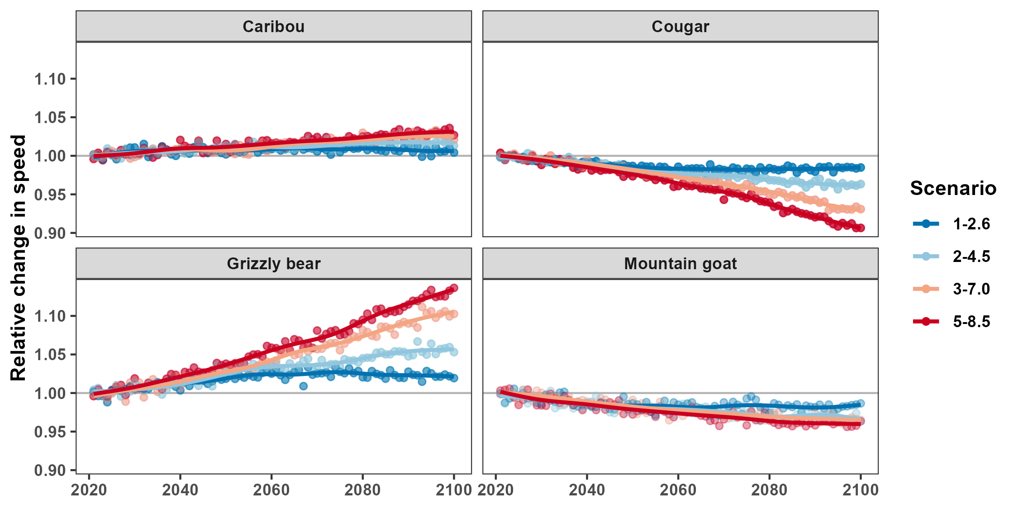






How climate change will shape the future of human-wildlife conflict in BC’s protected areas
Stefano Mezzini – Ph.D. Biol. student

Slide 2
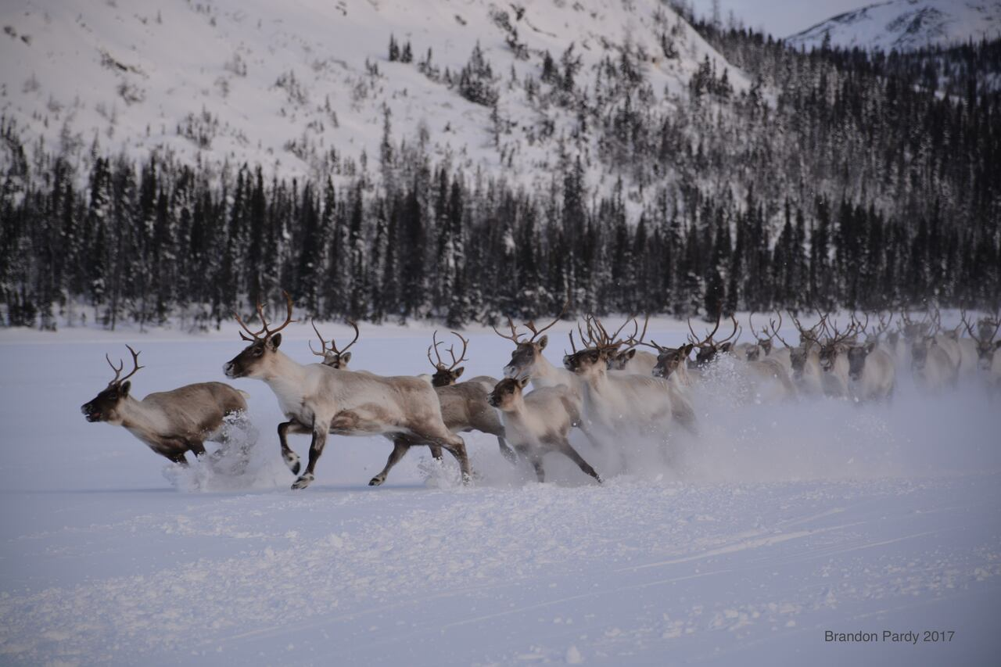
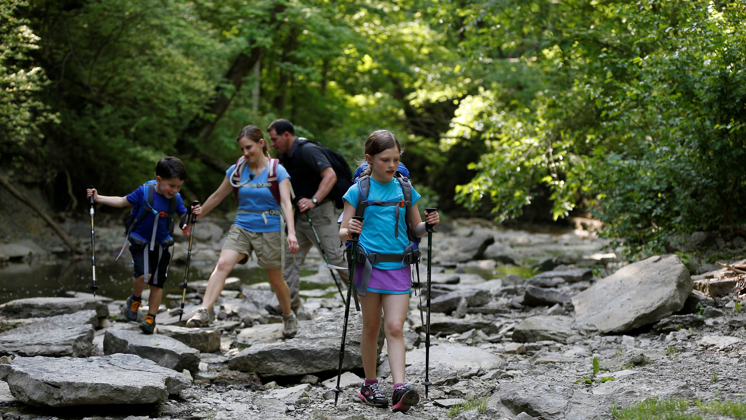
A two-part project
Minimizing human- wildlife conflict
Dayna Weststrate:
CC & park attendance
This talk:
CC & animal movement
© Gannet & Jeff Swinger
© Brandon Pardy

Slide 3
Human-Wildlife Conflict

Slide 4
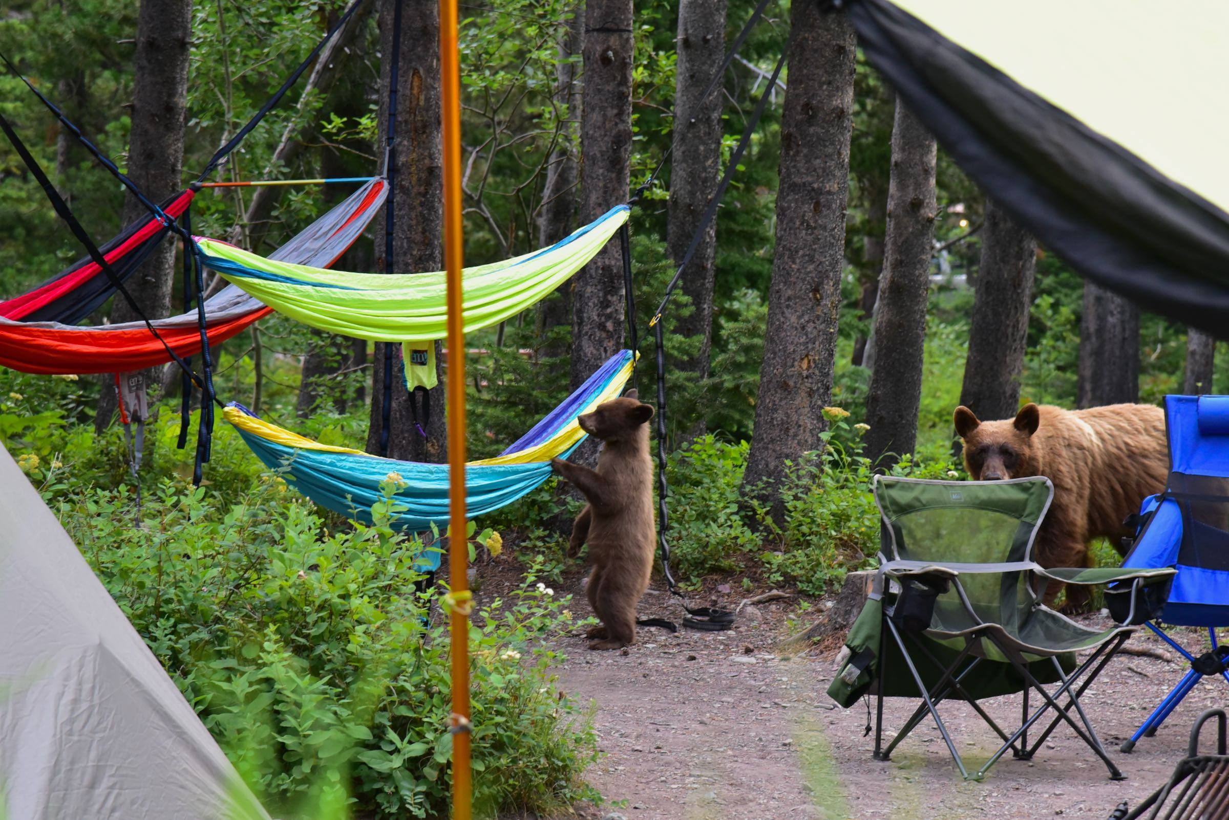
Human-wildlife conflict is scary…
Sensational topic
High risks for humans
High risks for animals
© wiscohana

Slide 5
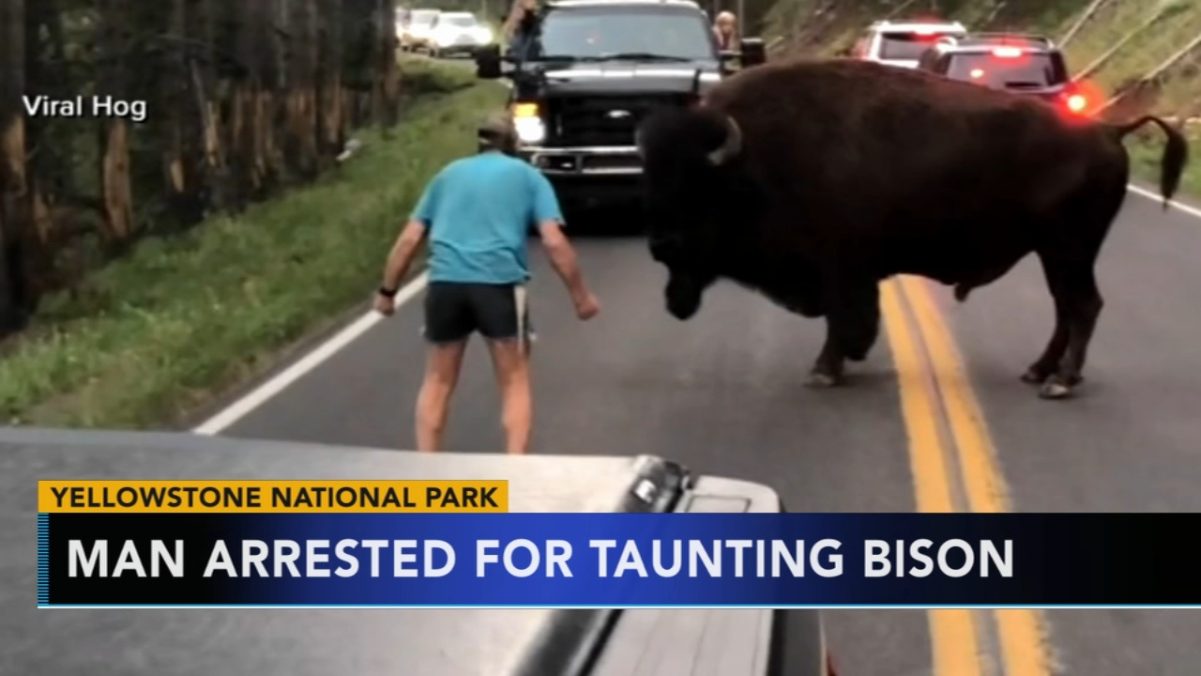
… but conflict goes both ways
Climate change
Habitat loss
Overhunting
Pointless confrontations…
© ABC News

Slide 6
Poking a sleeping bear

Slide 7
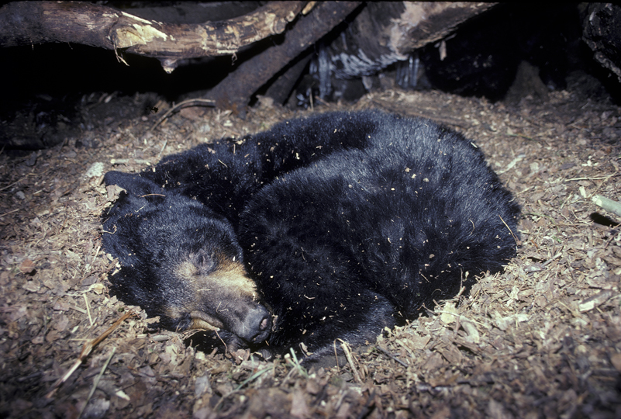
A hangry bear
© North American Bear Center

Slide 8
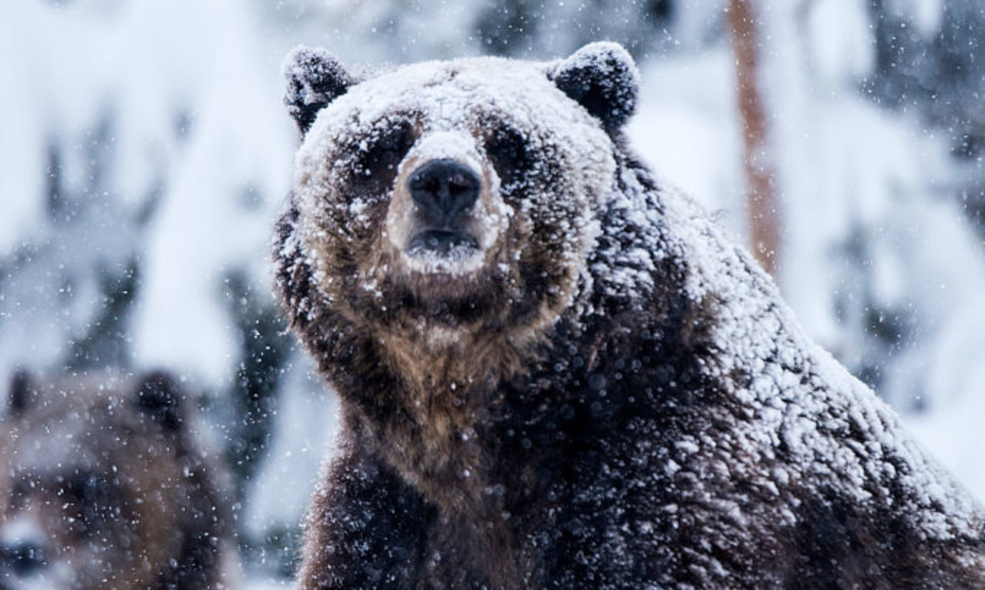
A hangry bear
© Prisma by Dukas/Universal Images Group

Slide 9
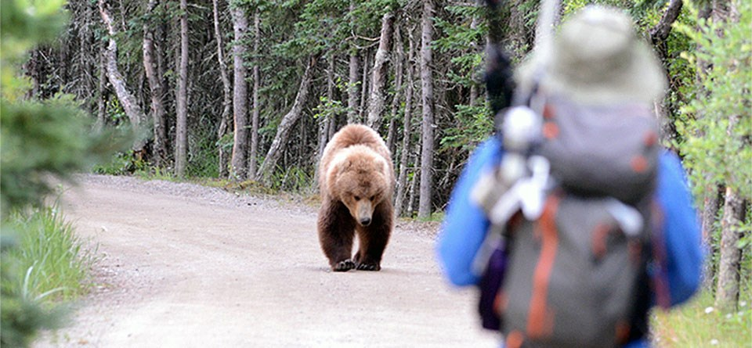
A hangry bear
© NPS Photo / Jake Bortscheller

Slide 10
Moving in a changing world

Slide 11
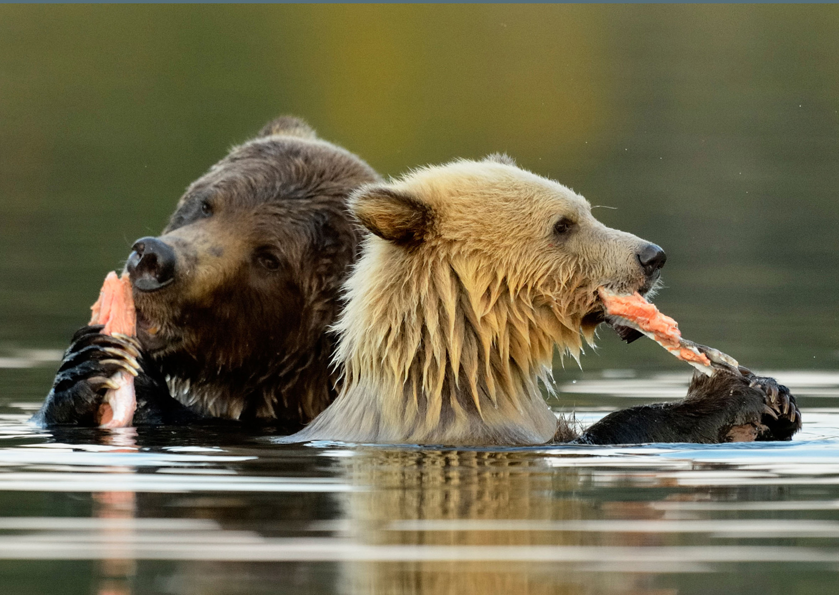
Maintaining an energetic balance
Require energy to survive
Move to collect resources
Collect more than you spend
Maintain an energetic balance
© Don Johnston_WC/Alamy Stock Photo (cropped)

Slide 12
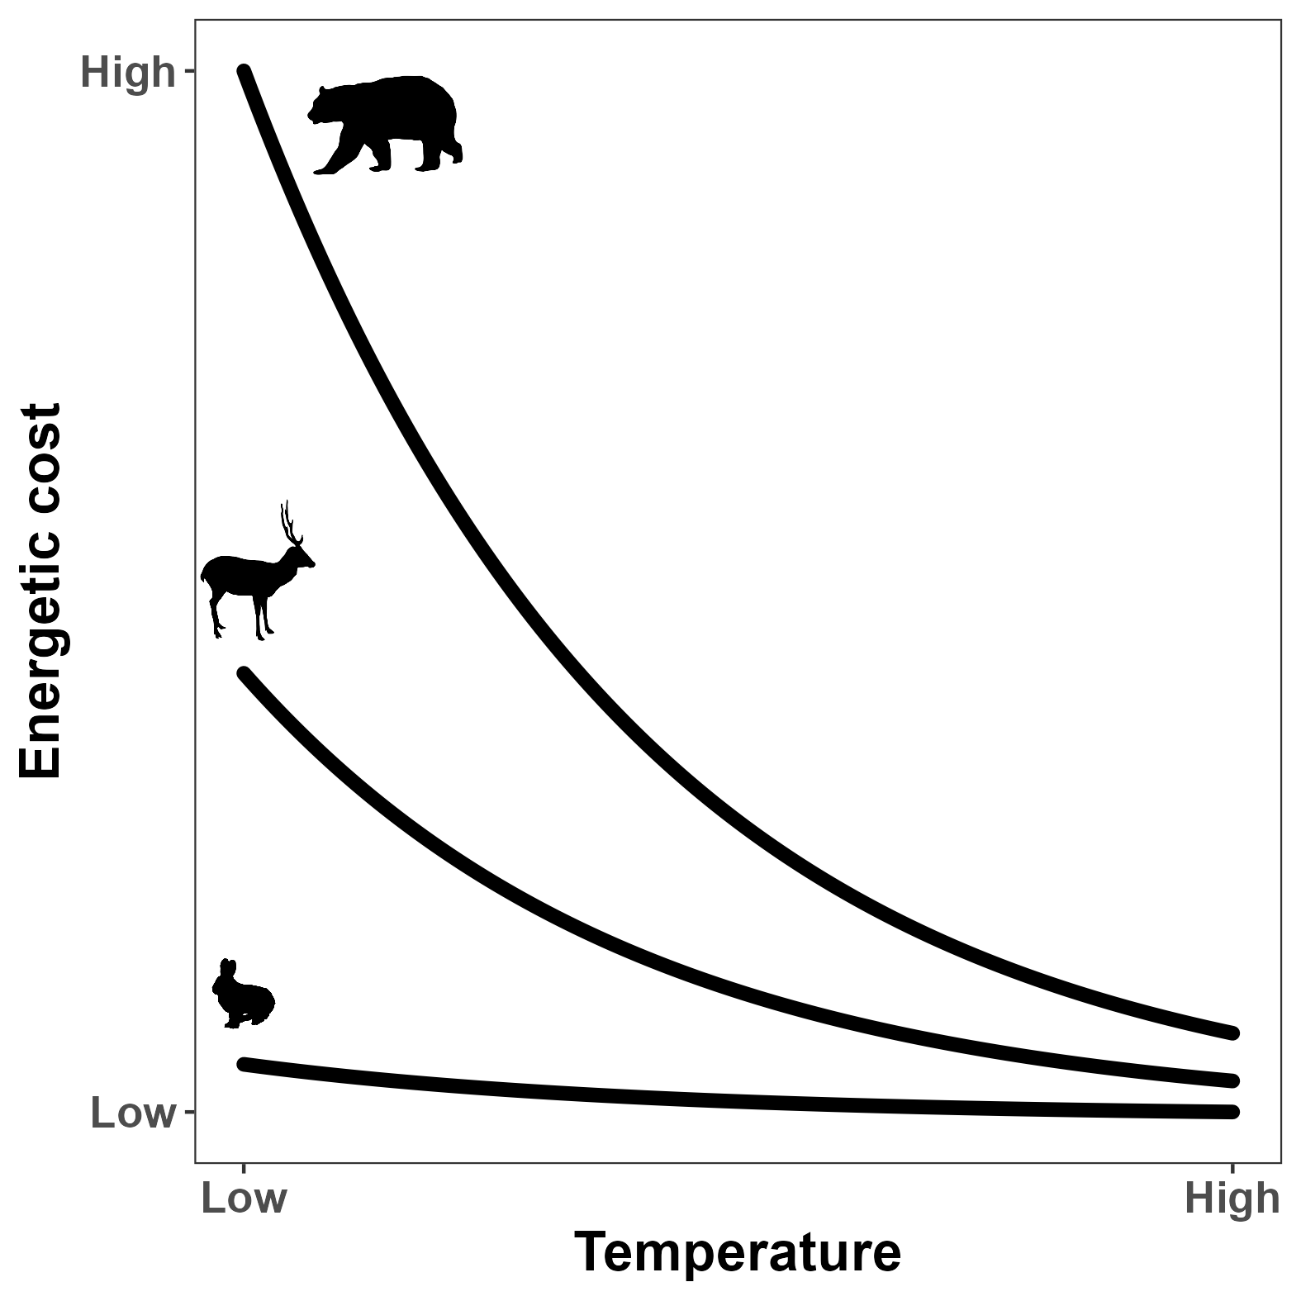

Energetic costs depends on temperature
$$I = I0 M^{3/4} e^{−cT}$$
(Brown et al. 2004)

Slide 13
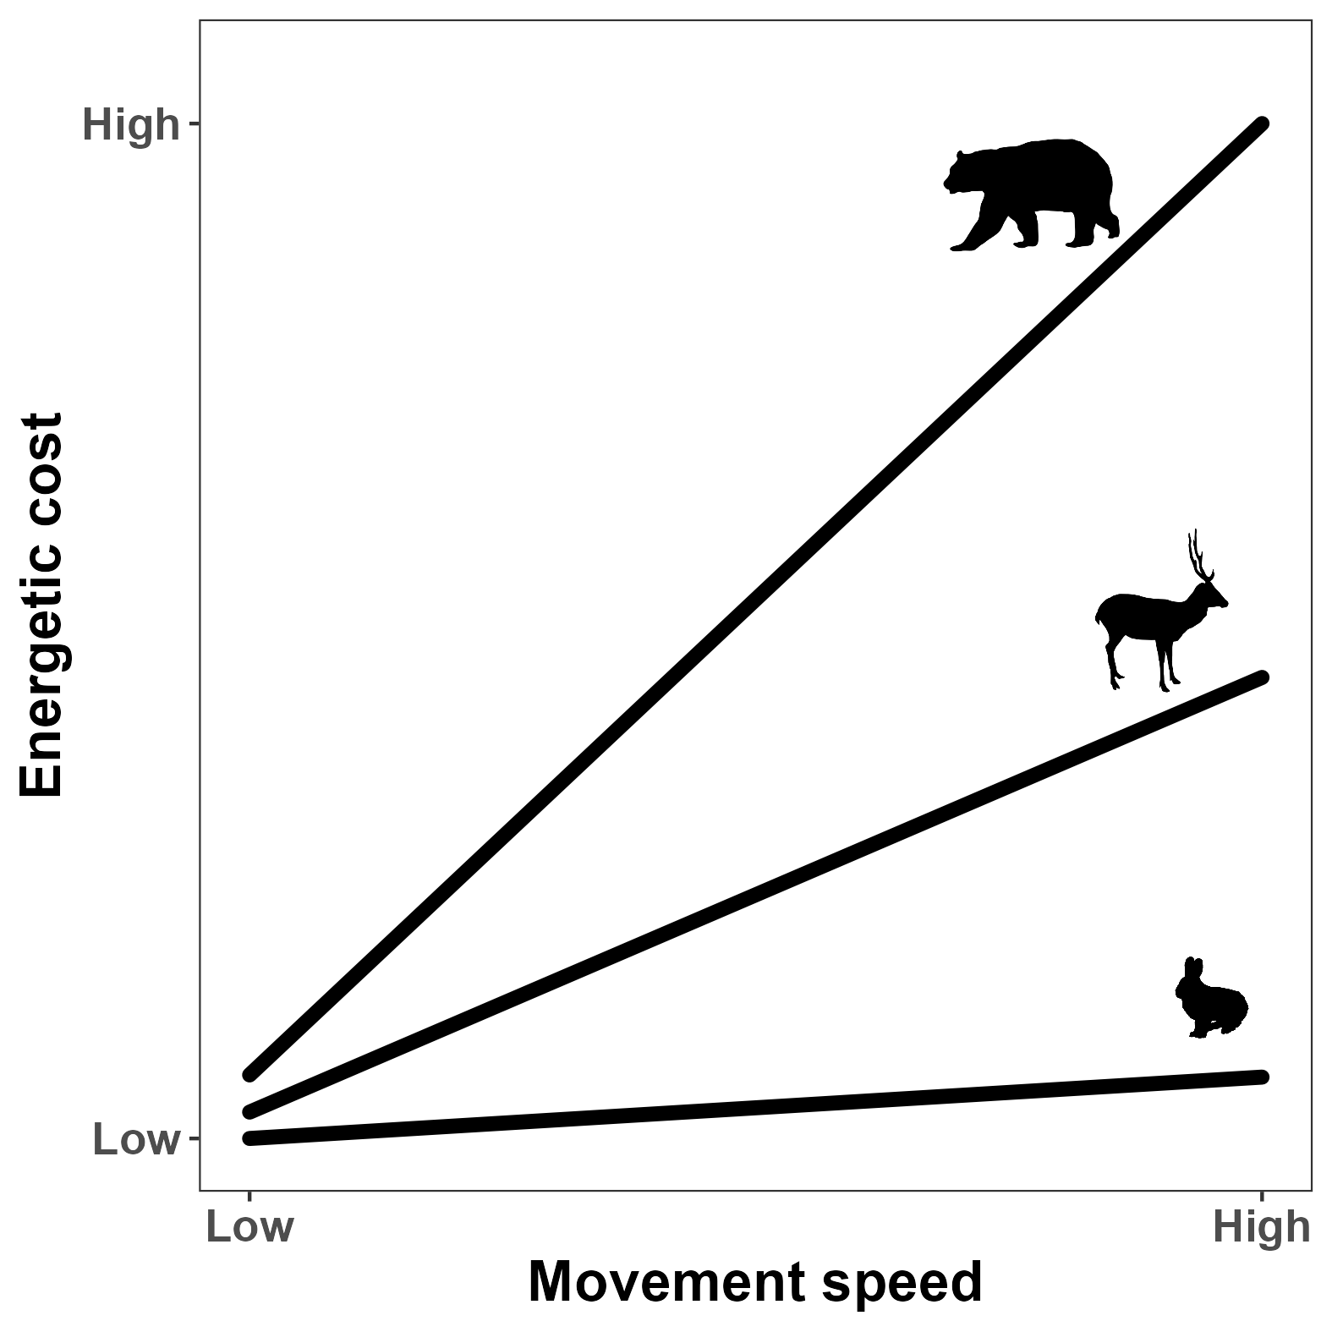
Movement comes at a cost
$$E=10.7 M^{−0.684} v+6.03 M^{−0.697}$$
(Taylor et al. 1982)

Slide 14
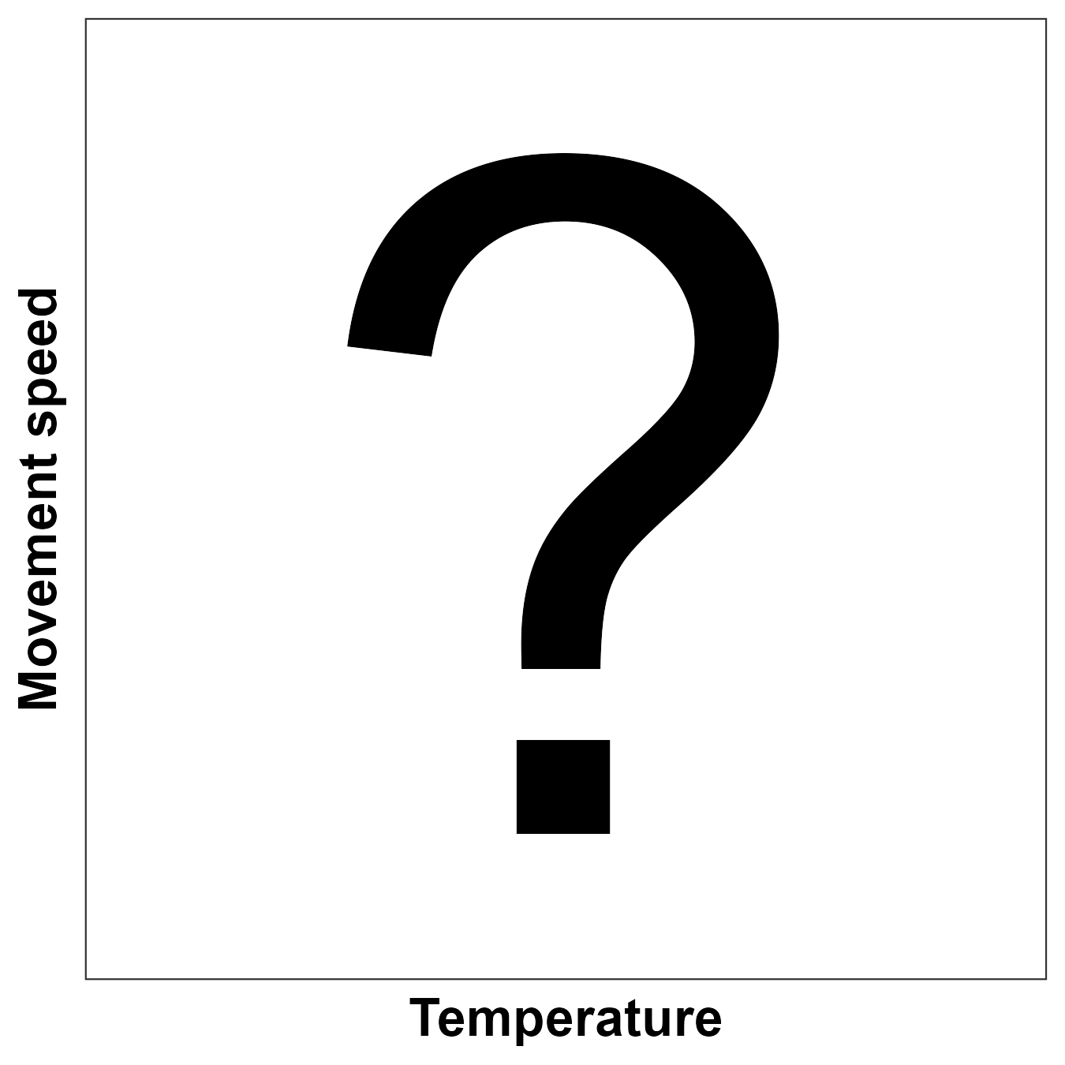
Does speed depend on temperature?

Slide 15
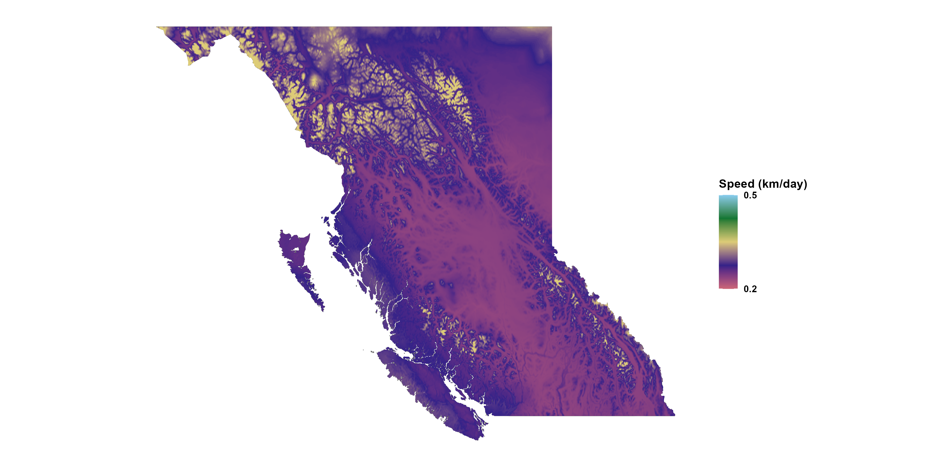
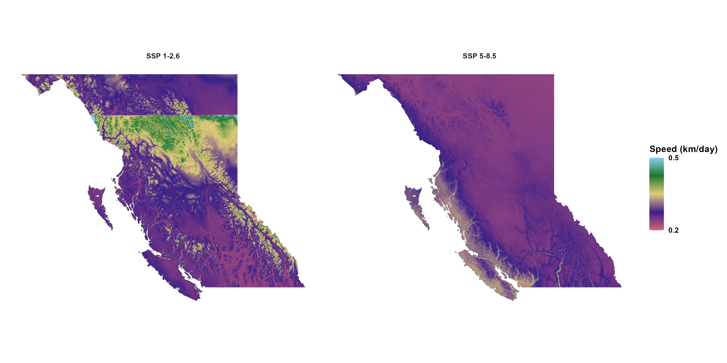
Predicting animal space use
Present
Effects of climate change on:
When animals move
How much animals move
Where animals move
Predict behavior and spatial use
Proactive management
2100

Slide 16
Modeling bear movement

Slide 17
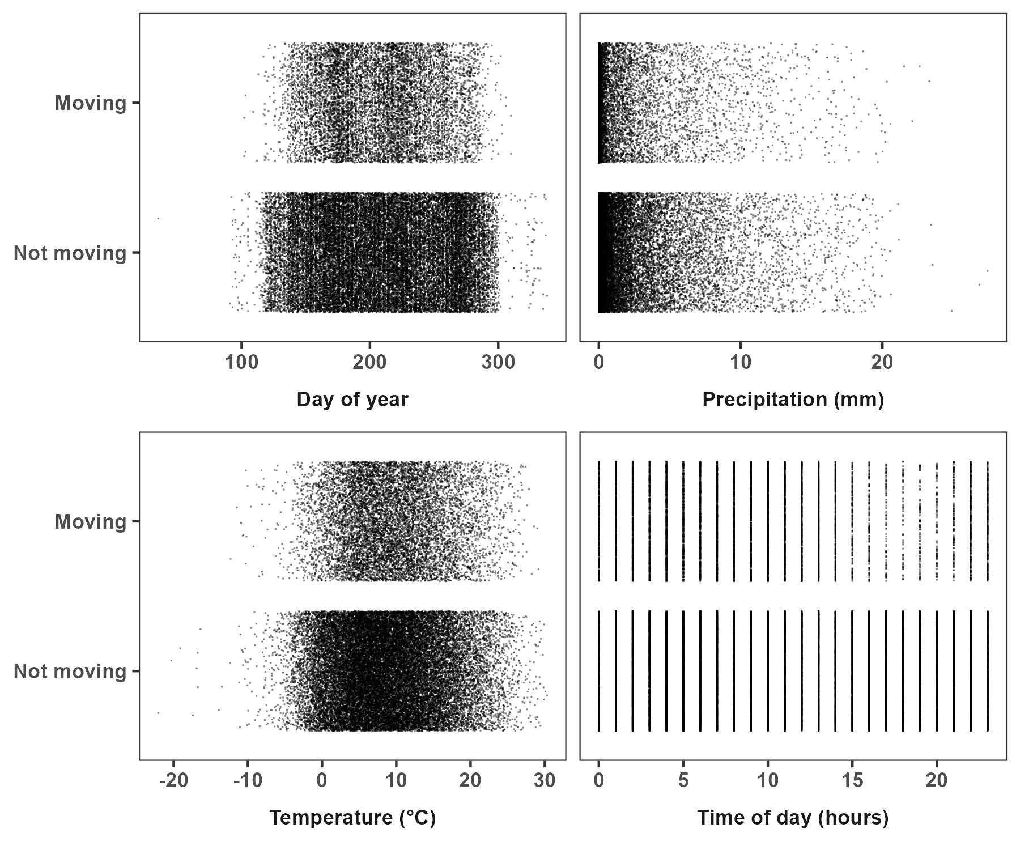
When do bears move?
Binomial model:
Moving: yes/no
Temperature (-25 to 30ºC)
Precipitation (0 to 27 mm)
Day of year (Feb to Dec)
Time of day (00:00, 24:00)

Slide 18
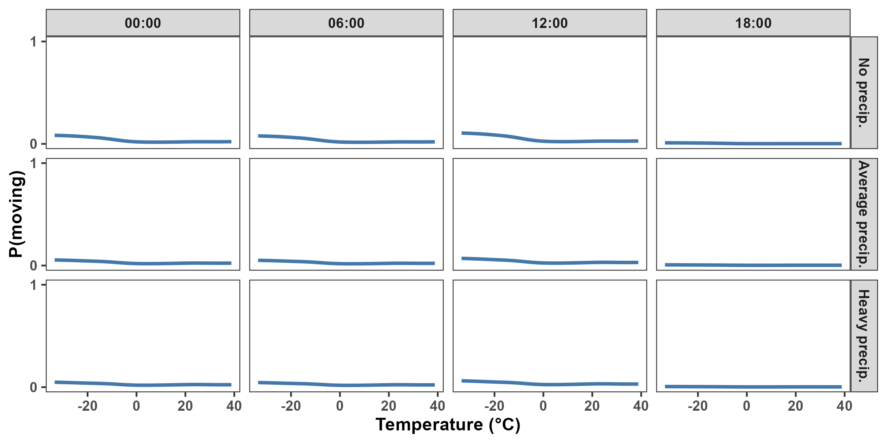
Predicting when bears move (December 13th)

Slide 19
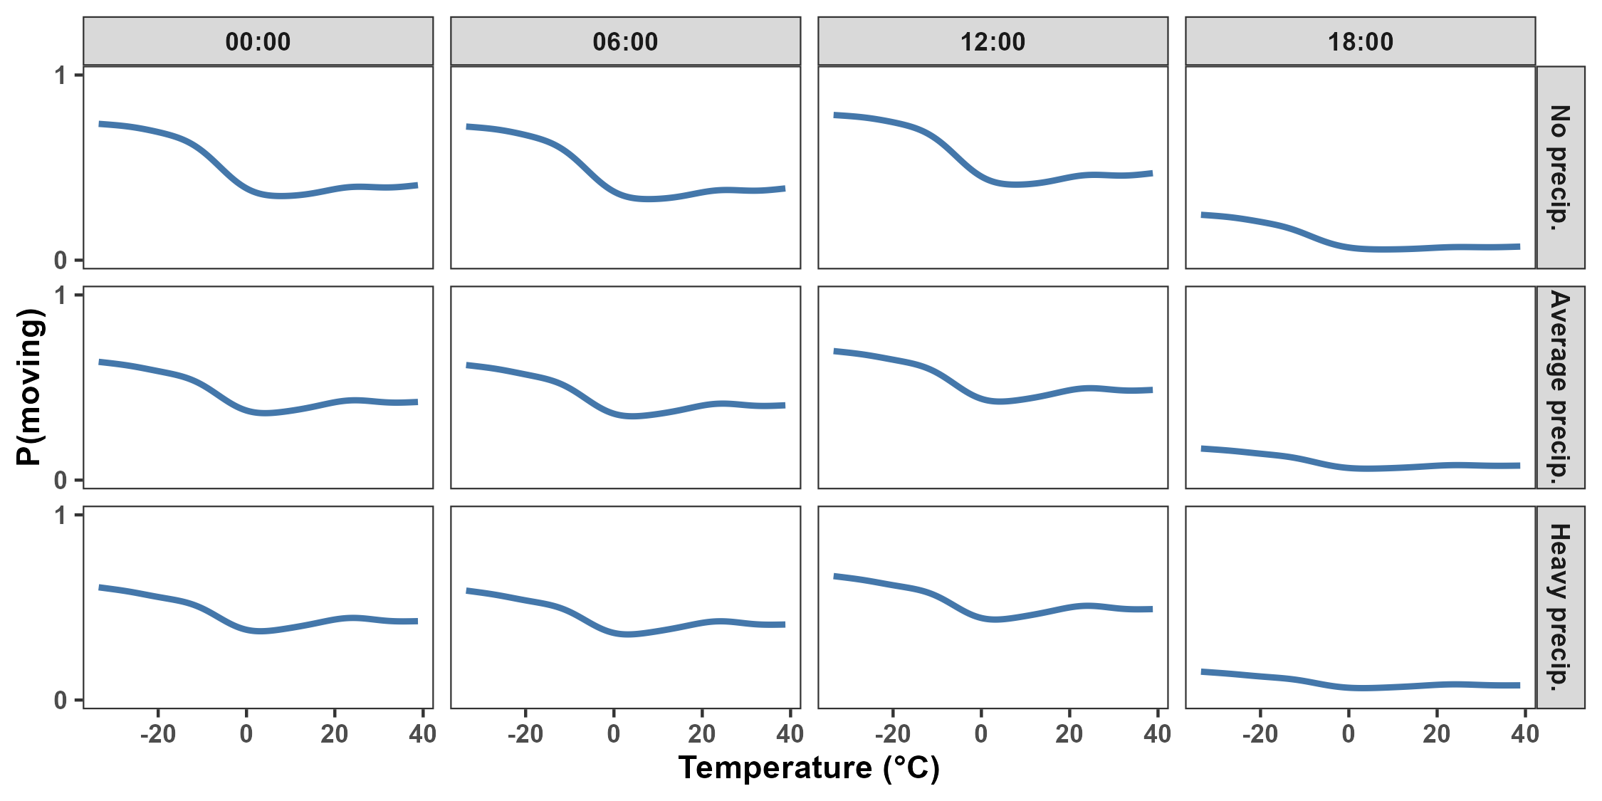
Predicting when bears move (June 15th)

Slide 20
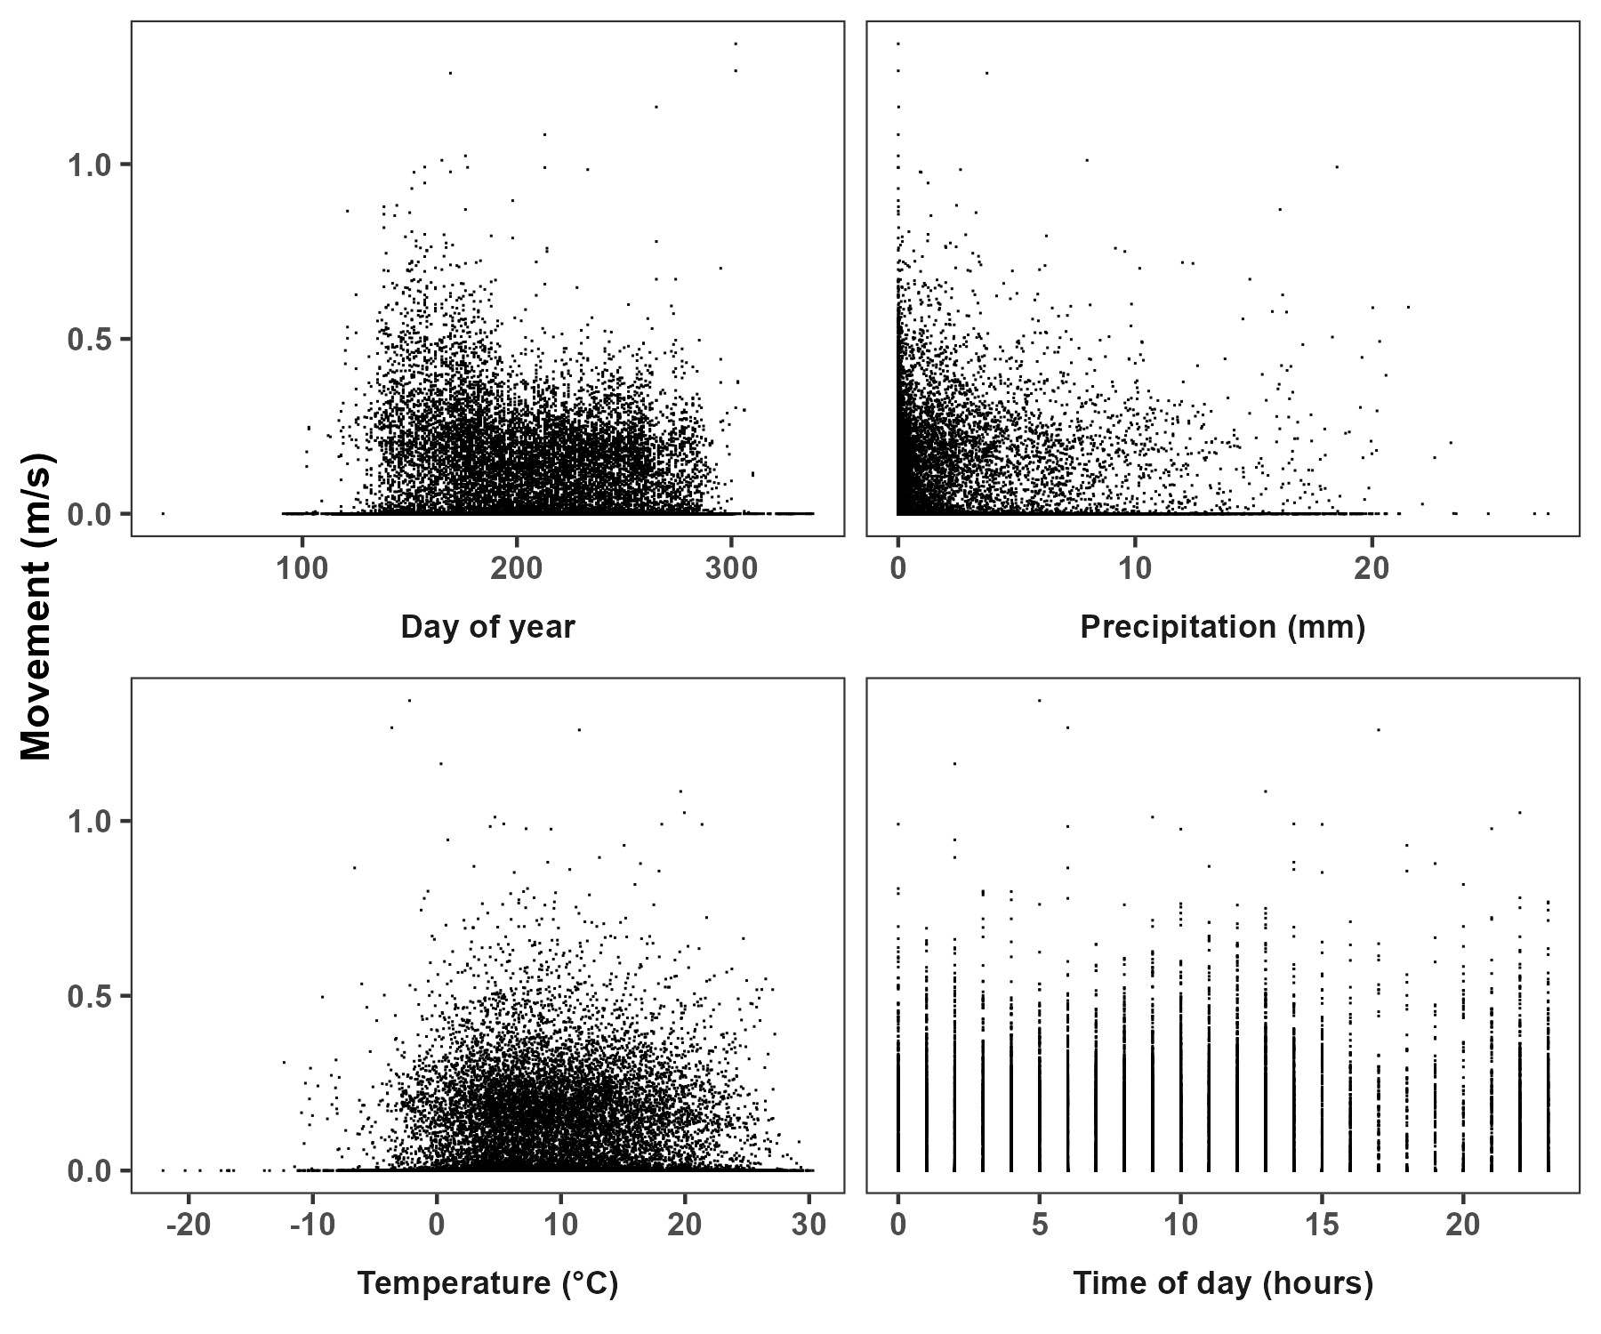
How much do bears move?
Gamma model:
Speed: > 0 m/s
Temperature (-25 to 30ºC)
Precipitation (0 to 27 mm)
Day of year (Feb to Dec)
Time of day (00:00, 24:00)

Slide 21
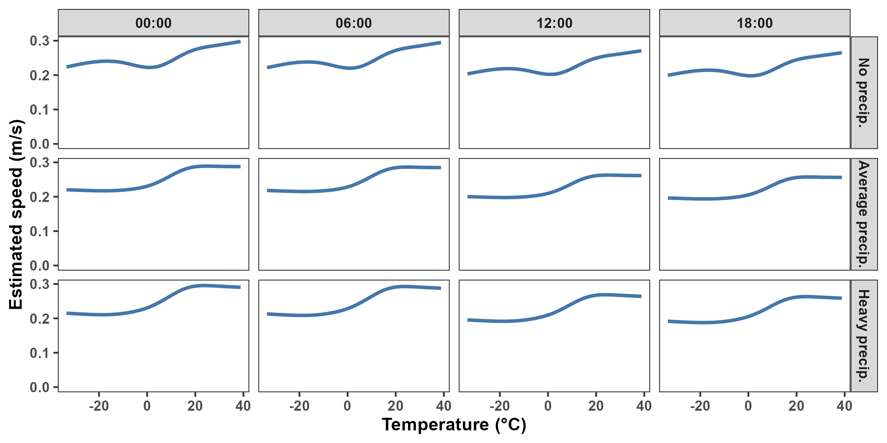
Predicting how much bears move

Slide 22
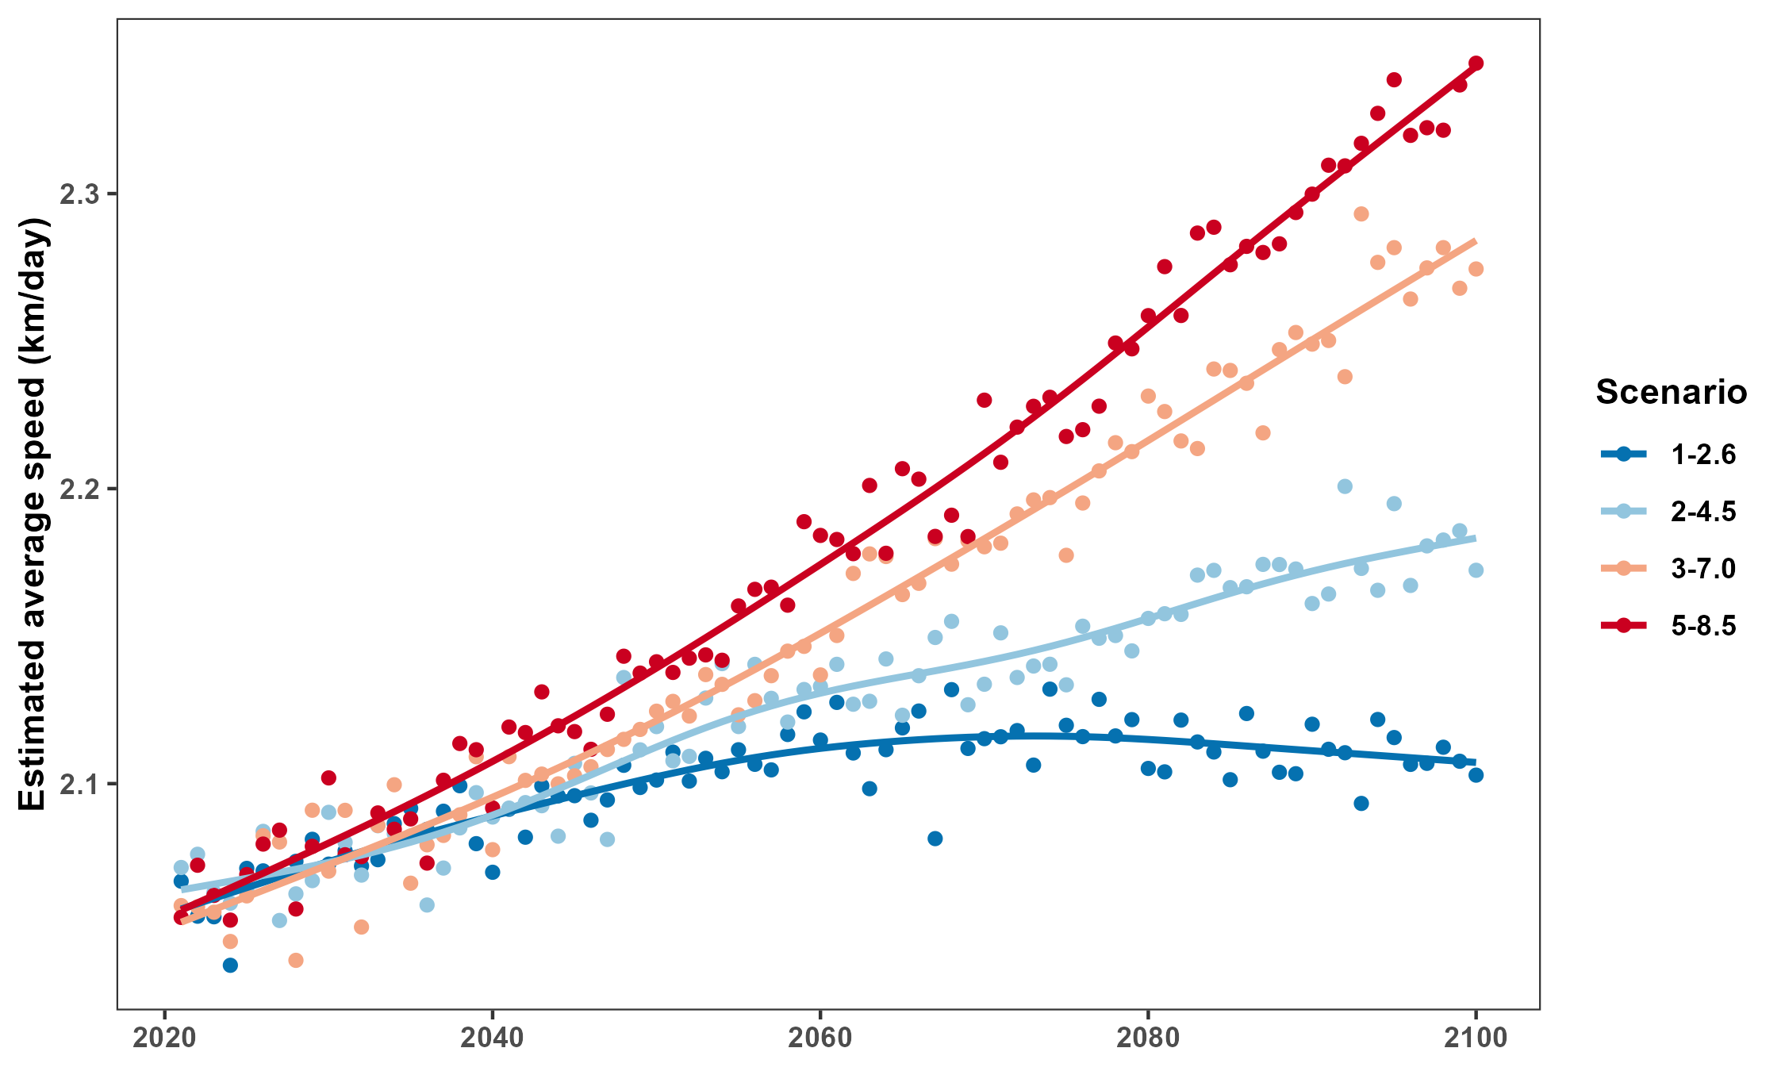
Predicting how bears will move in the future

Slide 23
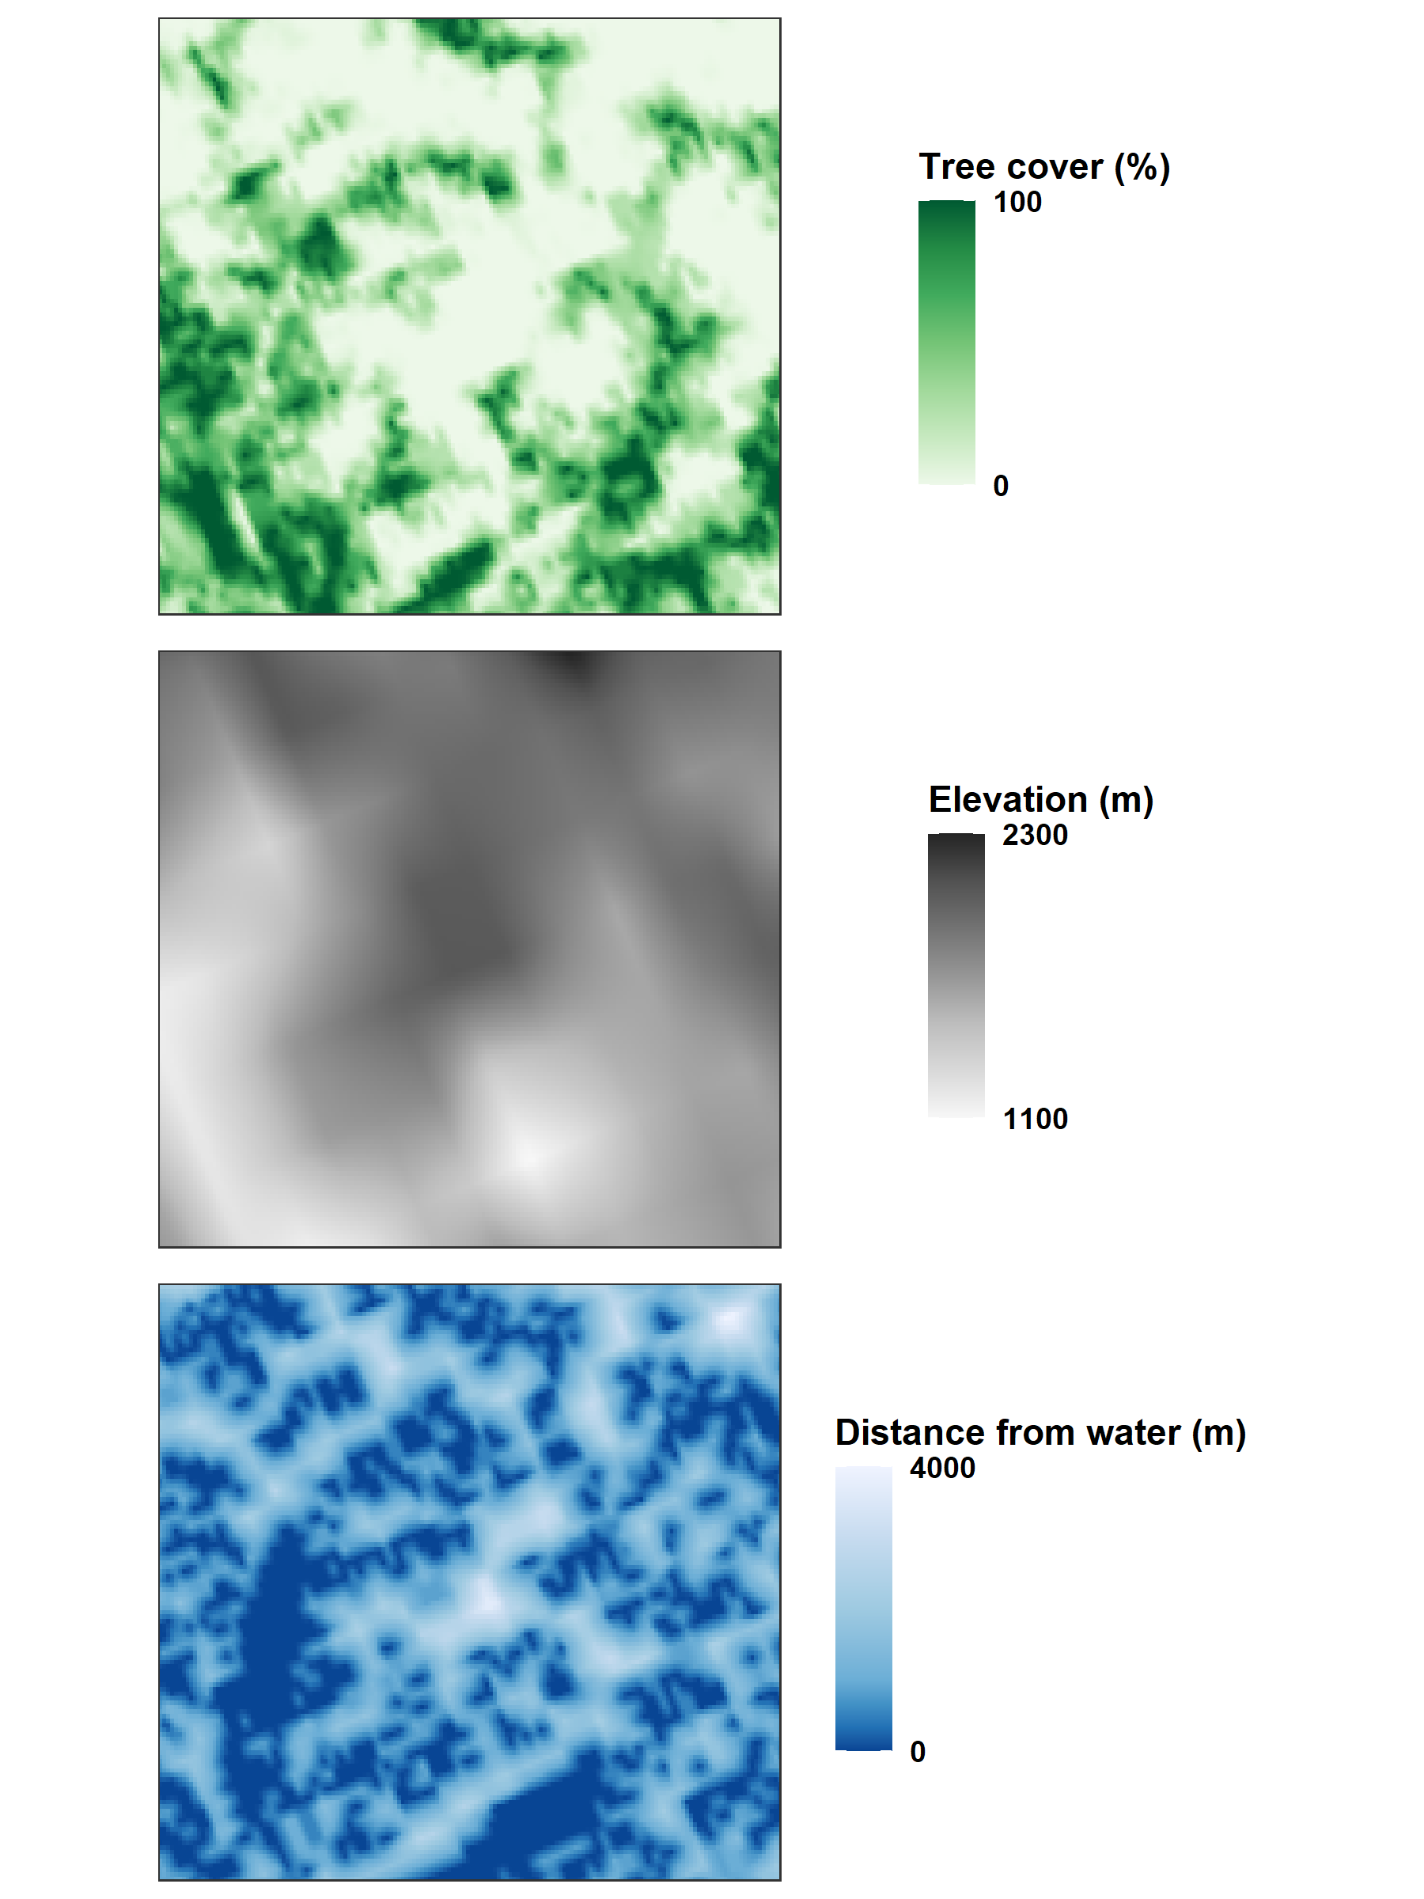
Where do bears move?
Integrated Resource Selection Function (iRSF; Alston et al. 2022):
Tree cover (0% – 100%)
Elevation (m)
Distance from water (m)
Temperature interactions
Precipitation interactions

Slide 24
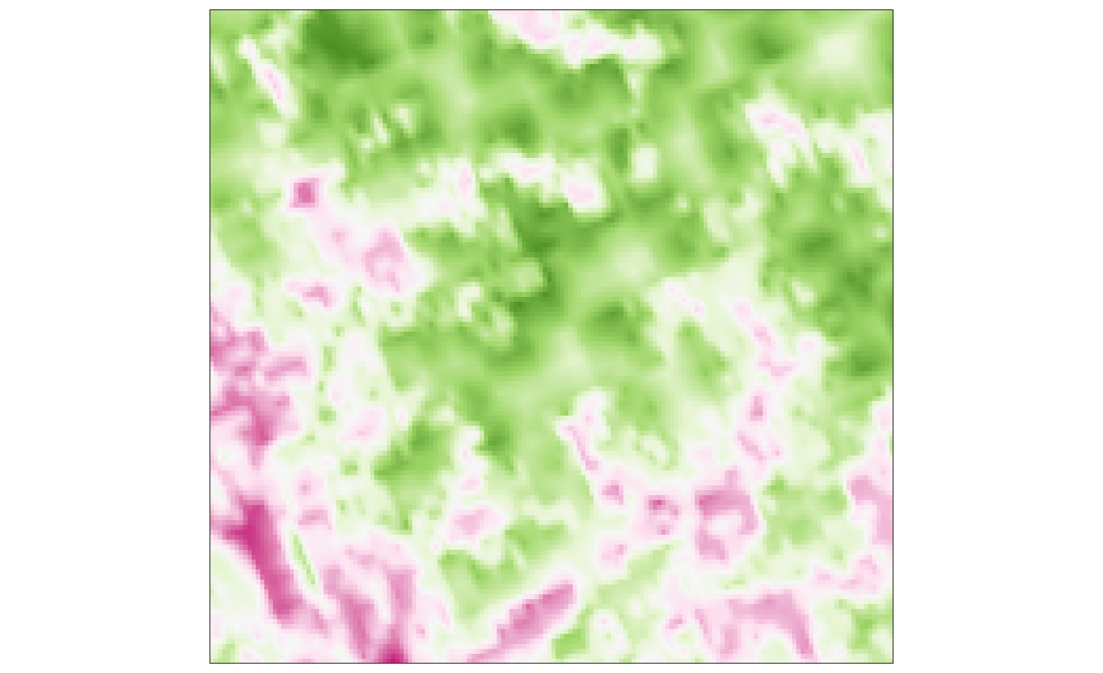
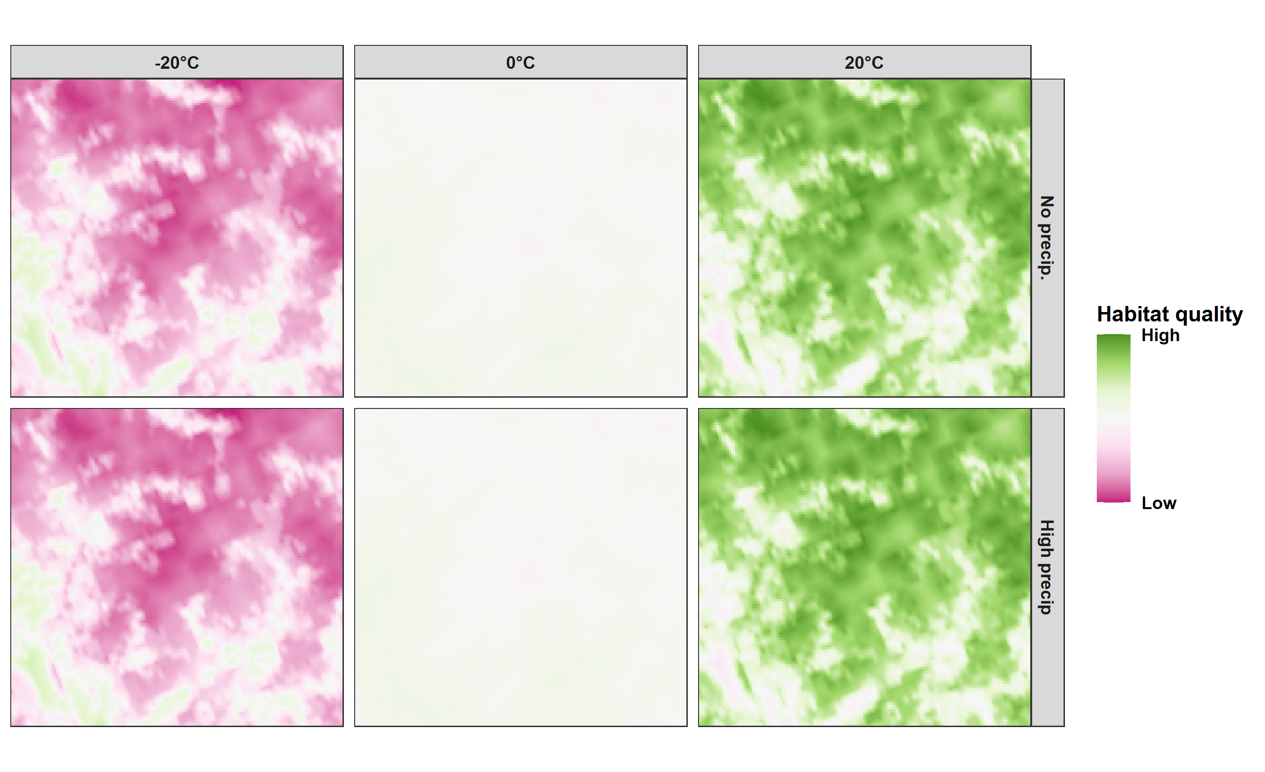
Where do bears move on a warm, dry day?

Slide 25
Where do bears move?

Slide 26
Including more species

Slide 27
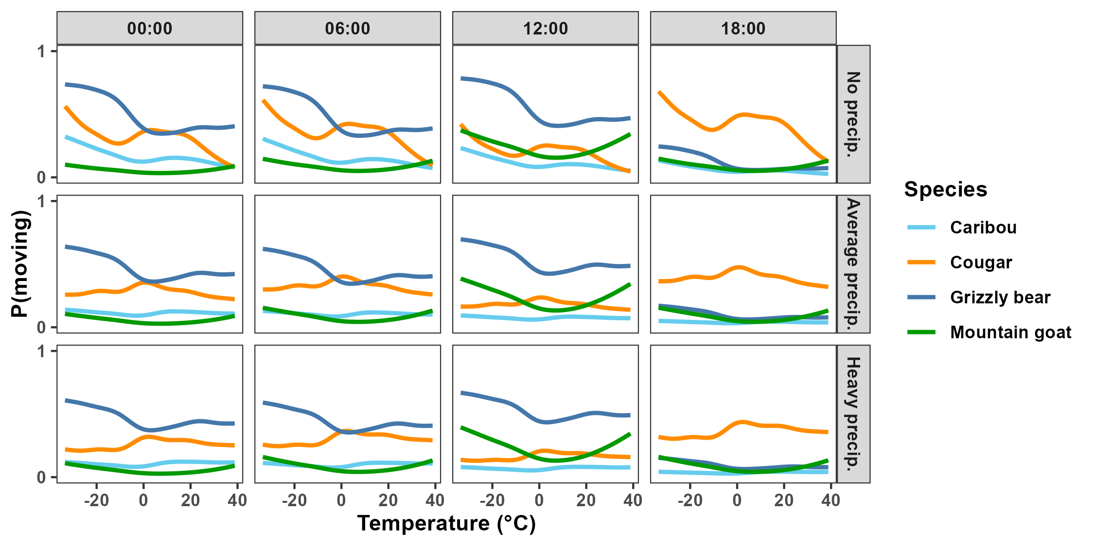
P(moving) varies strongly between species

Slide 28
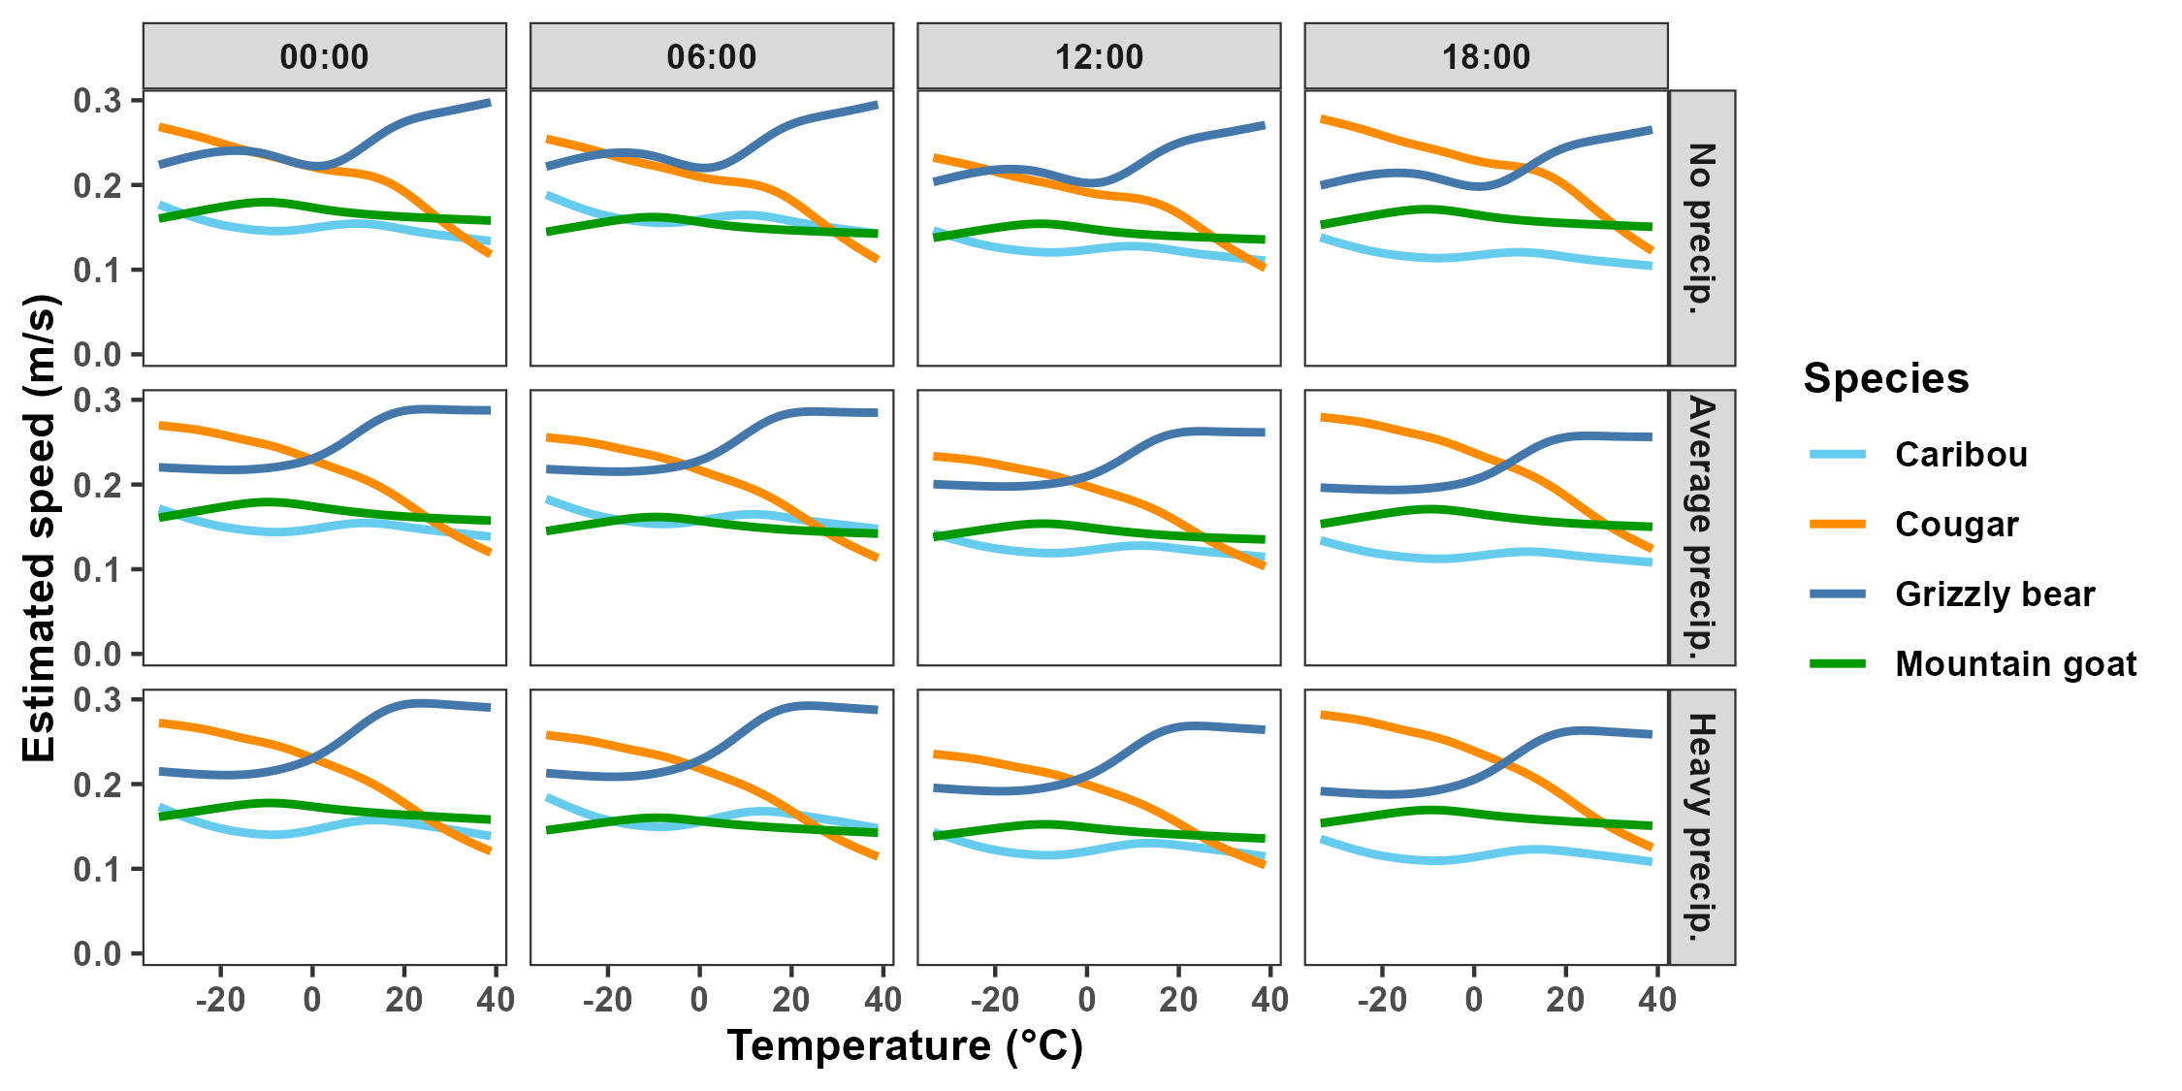
Average speeds vary strongly between species

Slide 29

Predicting into the future
Cougar: © CC BY-NC 3.0: C. Osorio & P. Carrera, Proyecto Carnivoros Australes Mountain goat: © CC-BY-SA 3.0: S. E. Haworth

Slide 30
Applications for conservation

Slide 31
Bear speed depends on the location

Slide 32
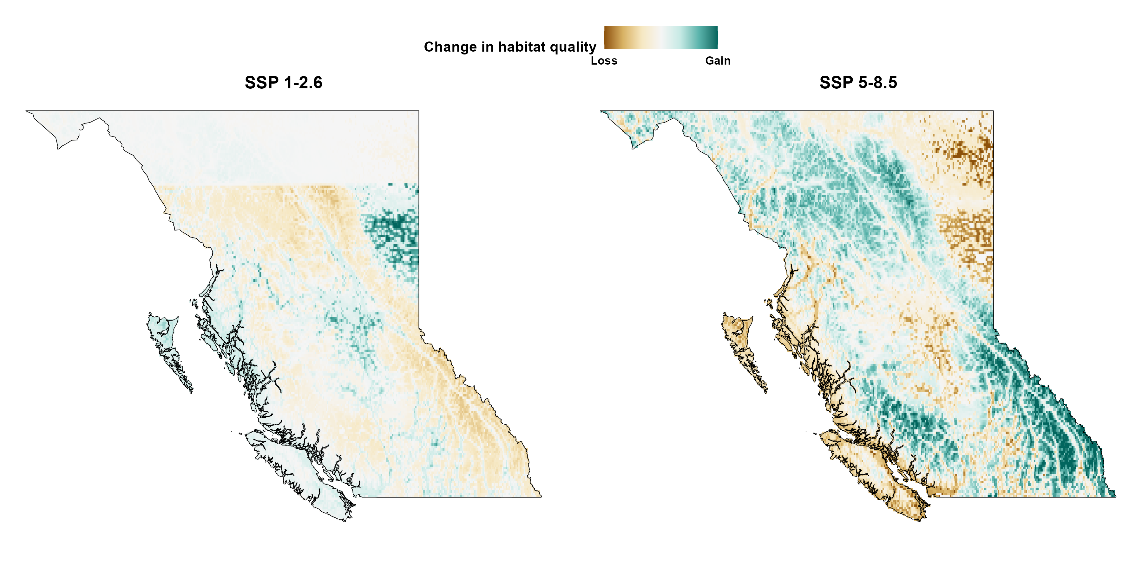
Bear speed depends on the climate scenario

Slide 33
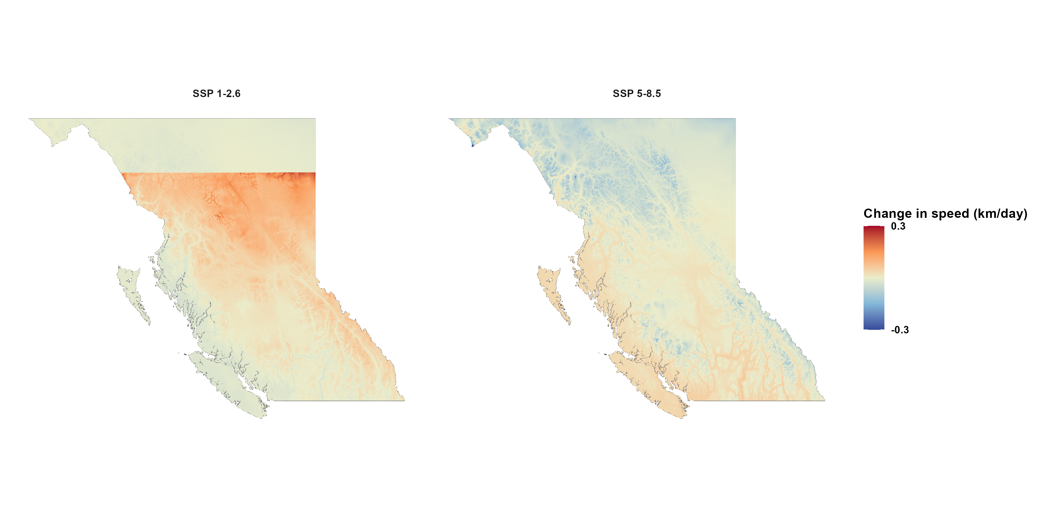
Changes in bear speed depend on the climate scenario

Slide 34
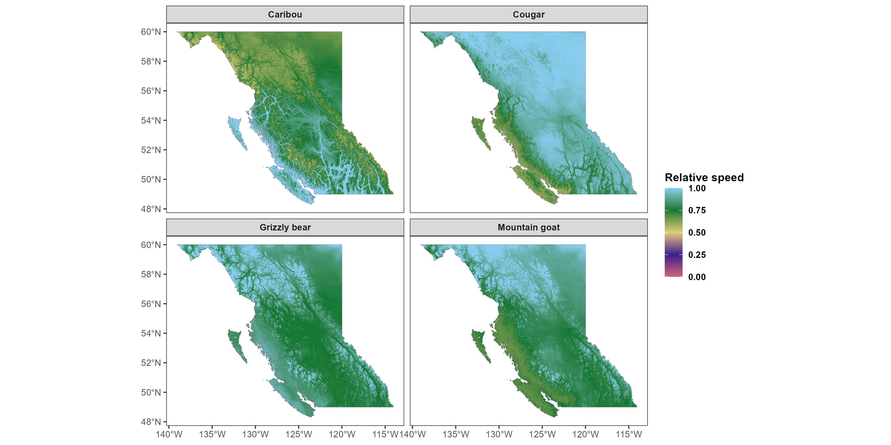


Estimating animal speeds in BC
Cougar: © CC BY-NC 3.0: C. Osorio & P. Carrera, Proyecto Carnivoros Australes
Mountain goat: © CC-BY-SA 3.0: S. E. Haworth

Slide 35
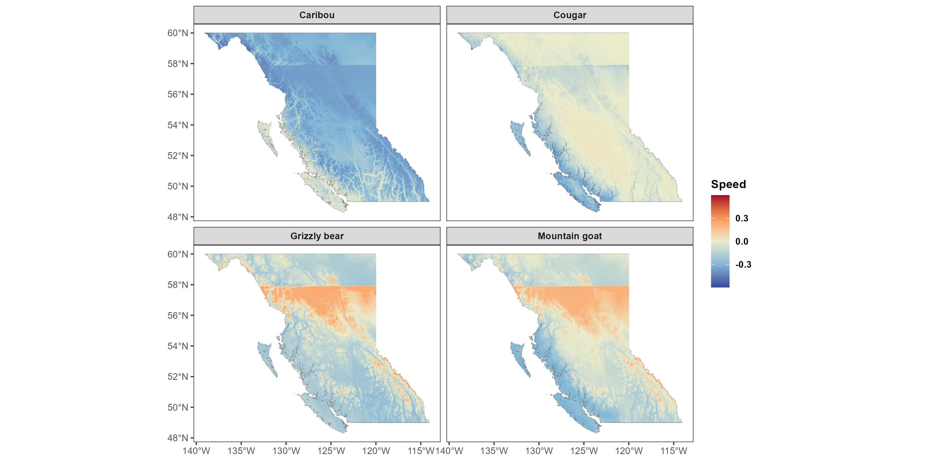





Predicting animal speeds in 2100 (best-case scenario)
Change in relative speed
Cougar: © CC BY-NC 3.0: C. Osorio & P. Carrera, Proyecto Carnivoros Australes
Mountain goat: © CC-BY-SA 3.0: S. E. Haworth

Slide 36
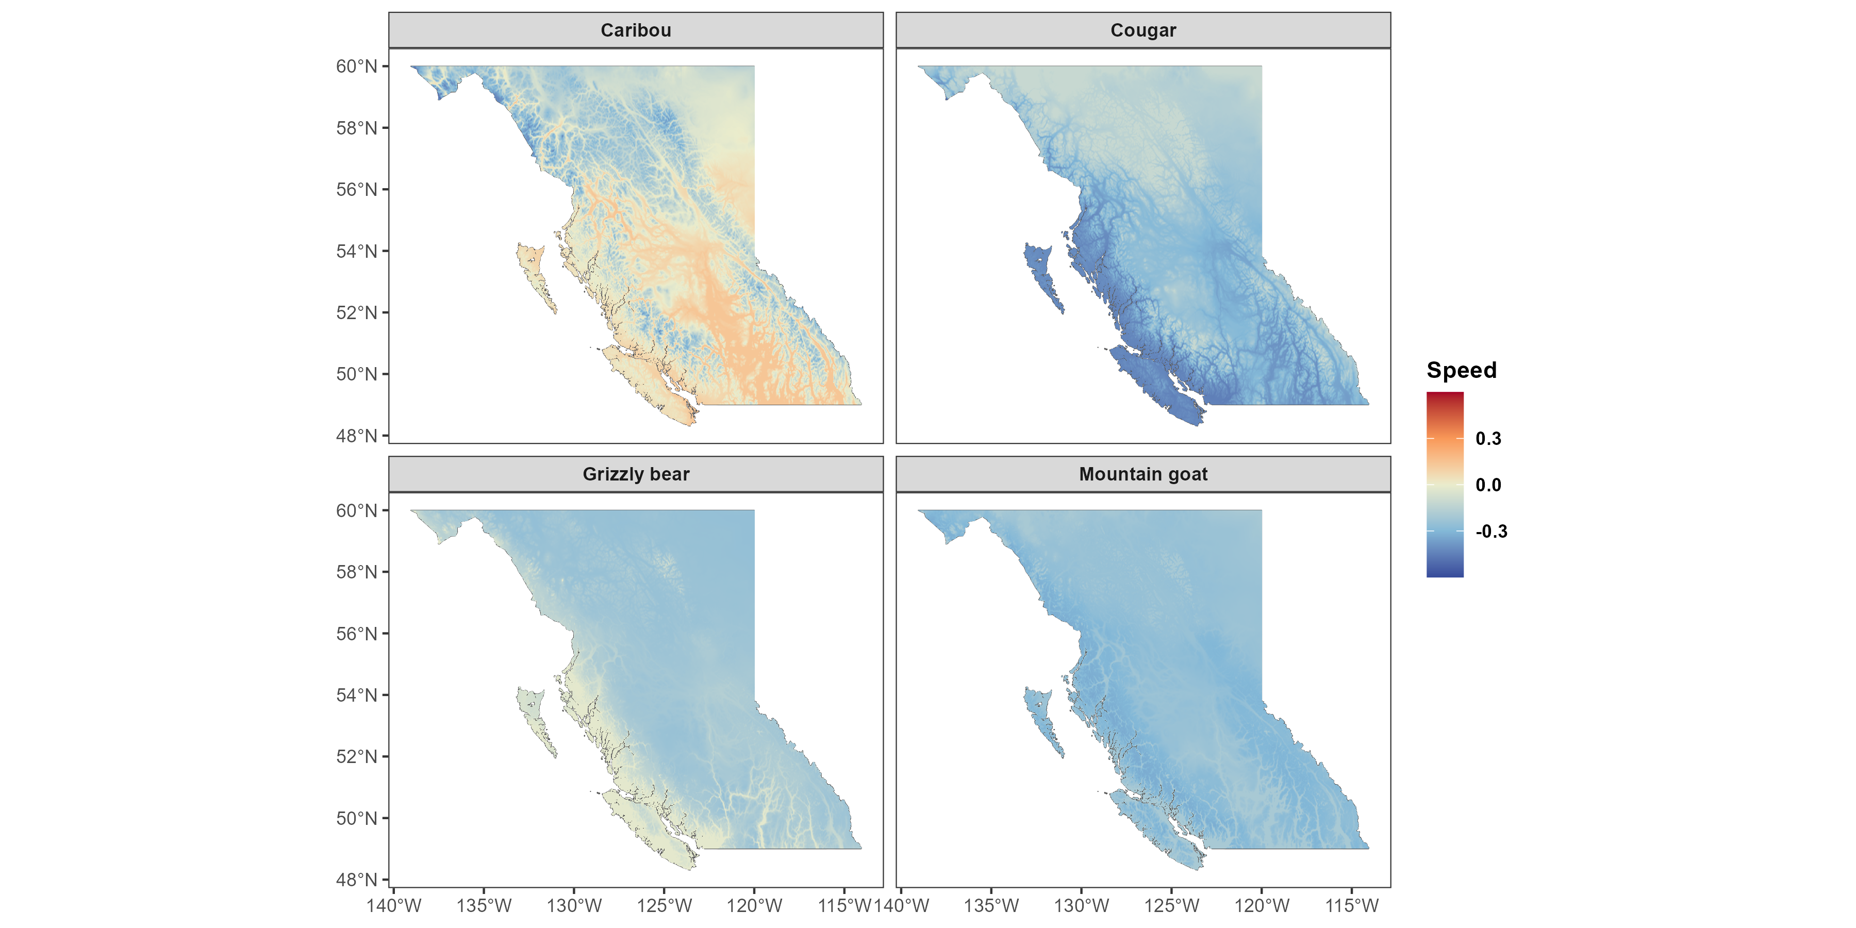
Predicting animal speeds in 2100 (worst-case scenario)
Change in relative speed
Cougar: © CC BY-NC 3.0: C. Osorio & P. Carrera, Proyecto Carnivoros Australes
Mountain goat: © CC-BY-SA 3.0: S. E. Haworth

Slide 37
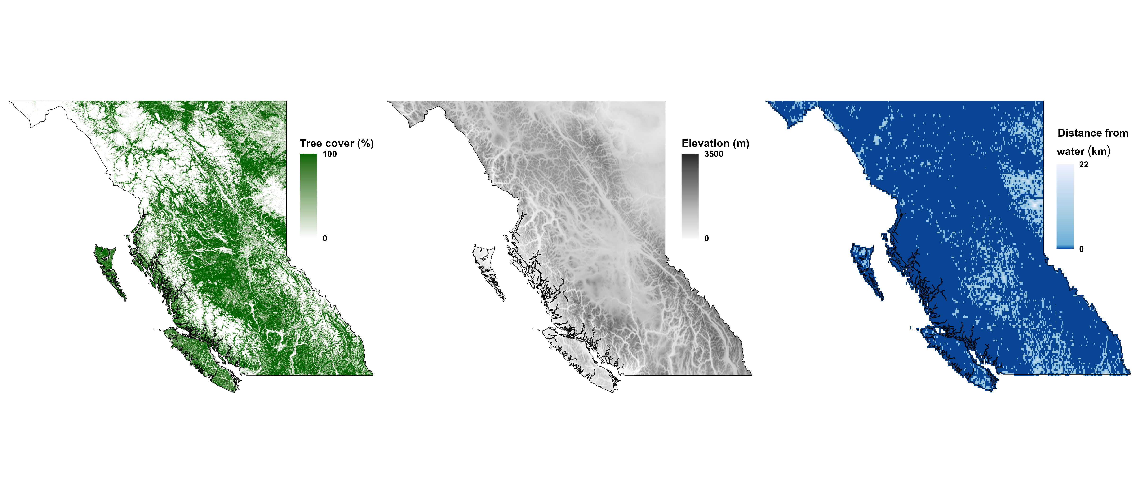
Bear habitat quality in 2005

Slide 38
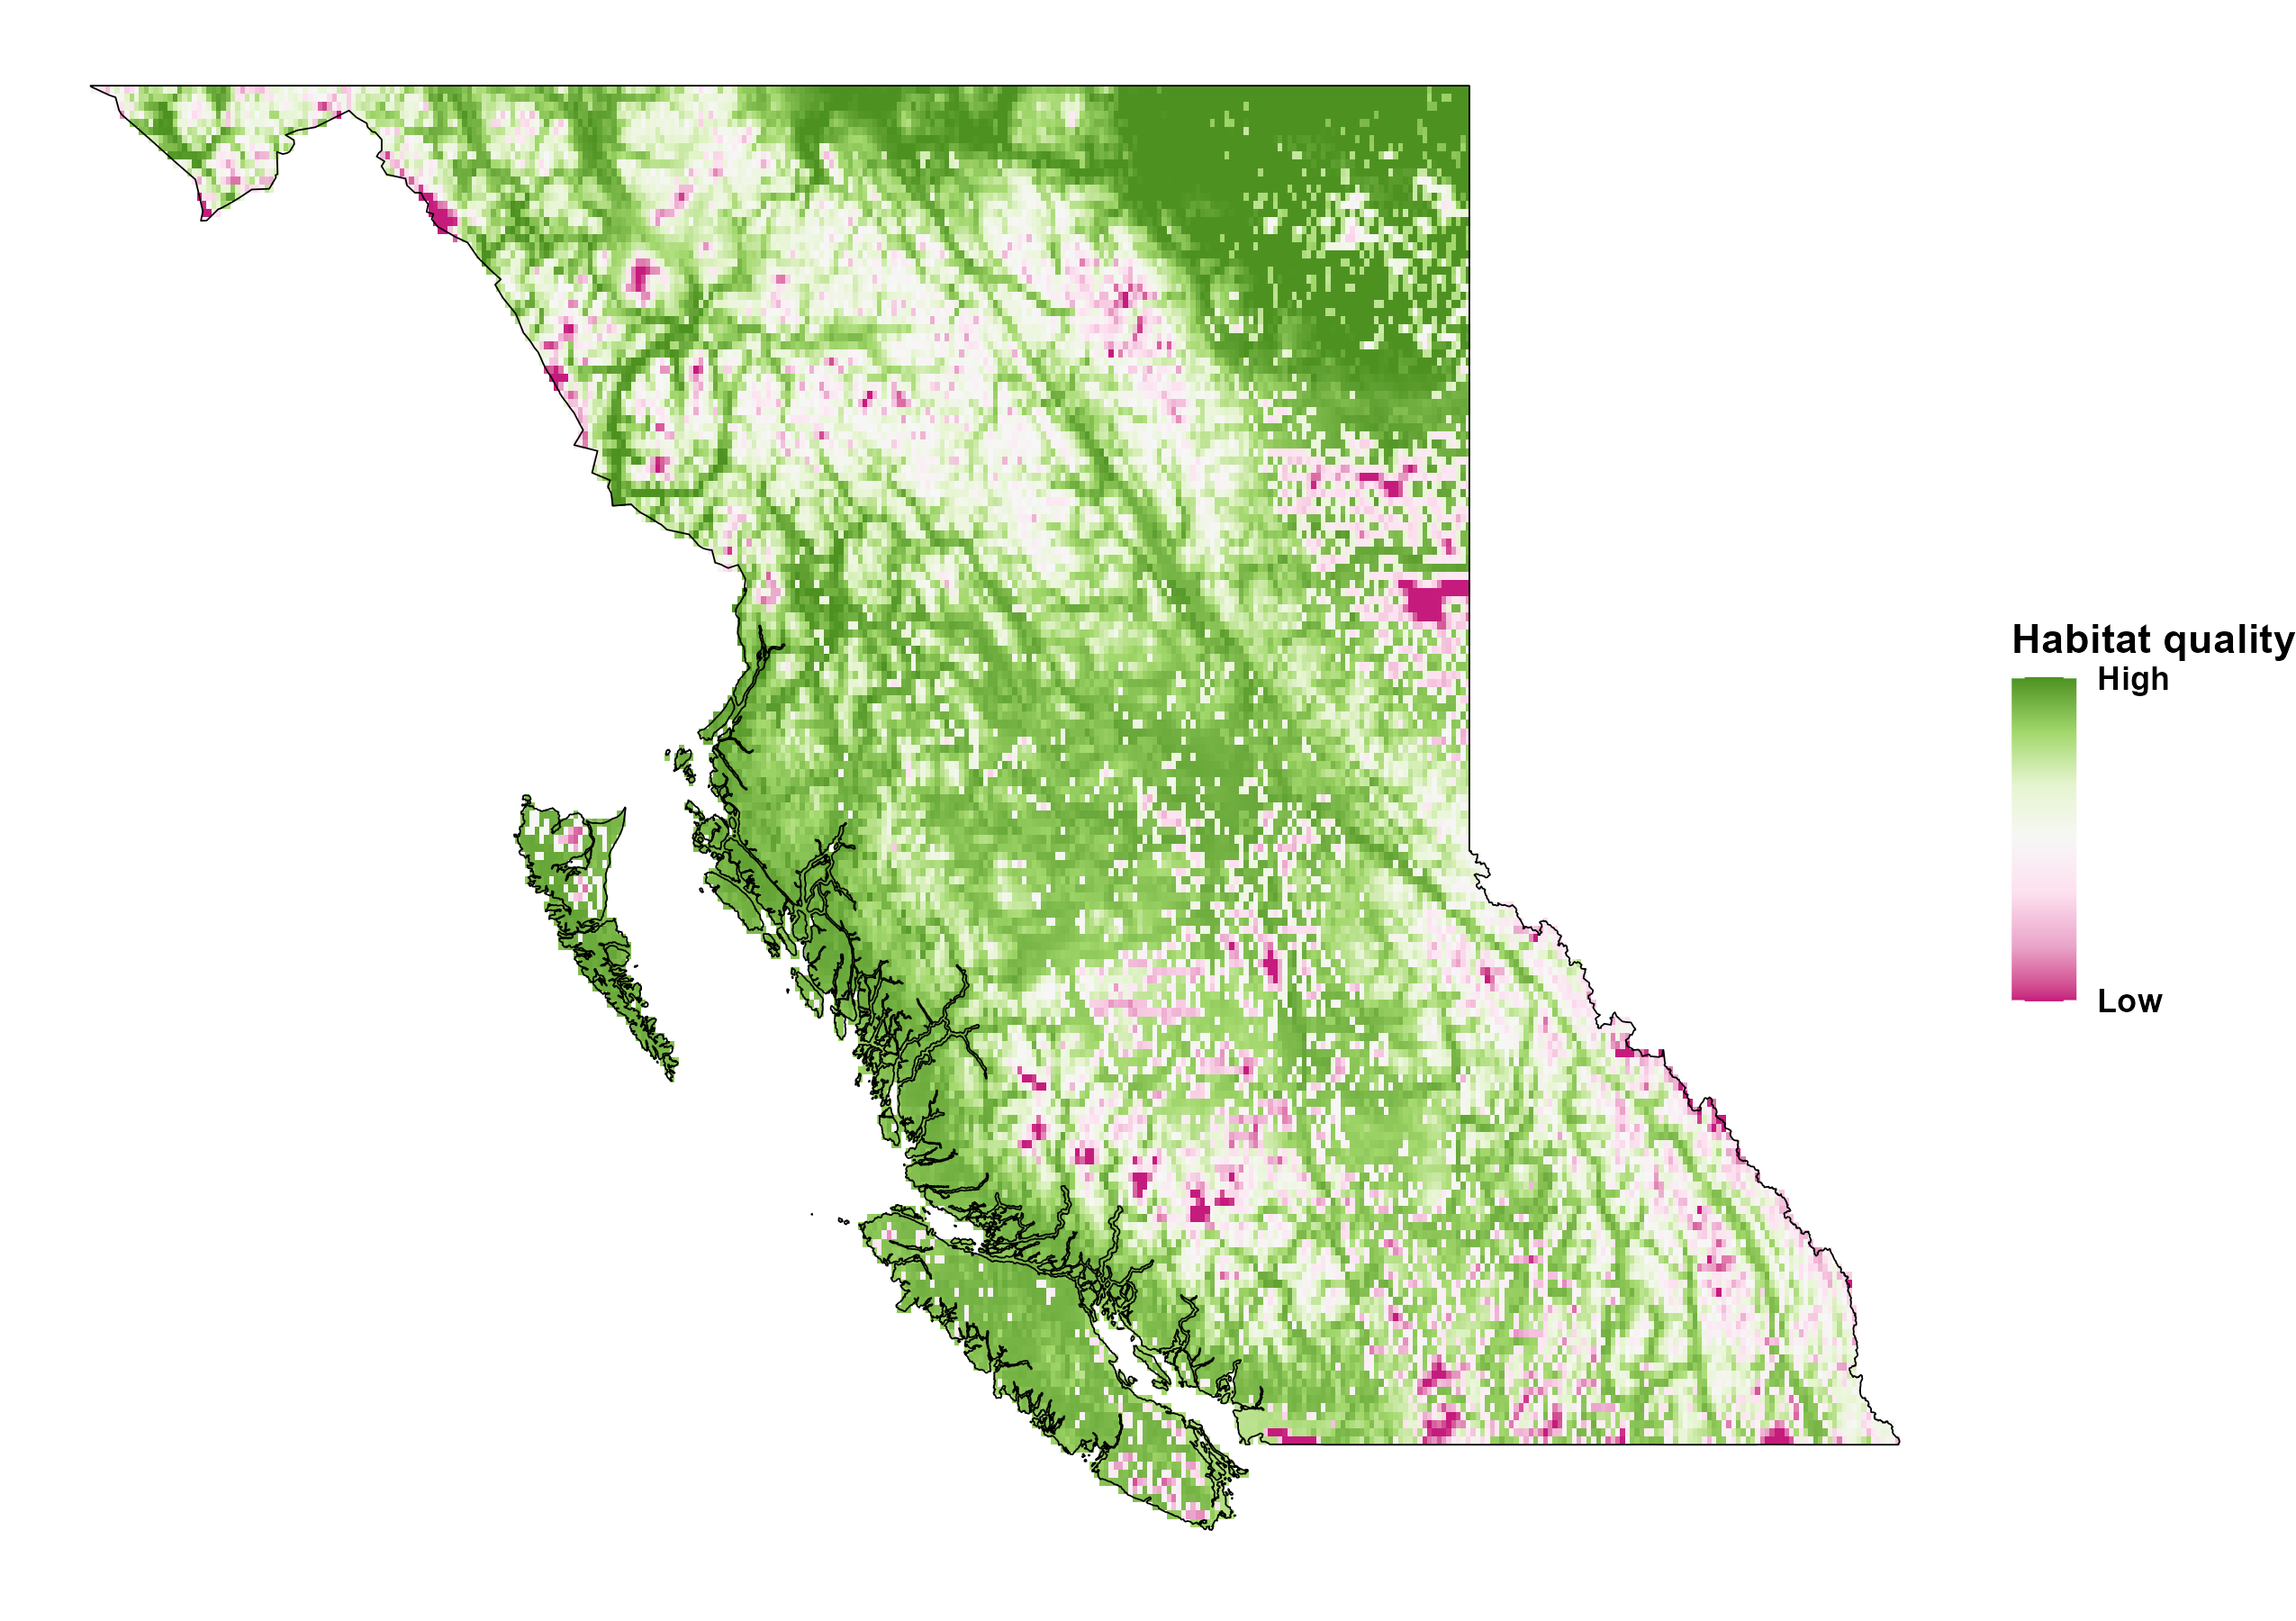
Bear habitat quality in 2005

Slide 39
Bear habitat in 2100

Slide 40
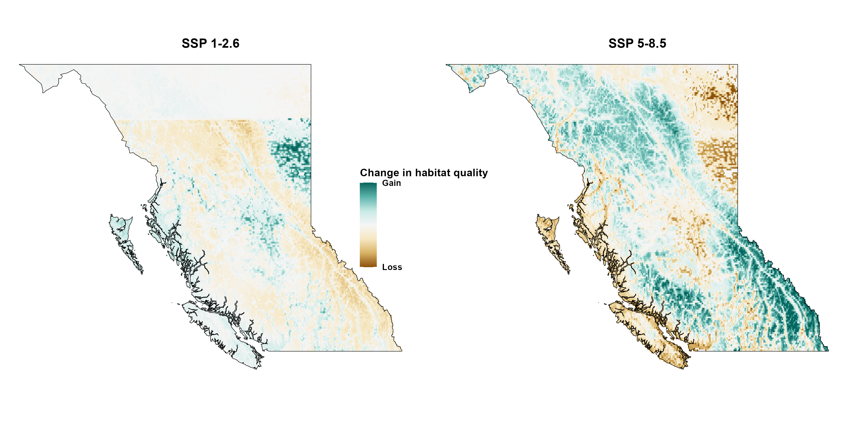
Bear habitat in 2100

Slide 41
Planning for the future
Movement depends strongly on temperature and species
Future of HWC depends strongly on CC scenario
Habitat quality depends on CC scenario
For bears:
SSP 1-2.6: prefer forested, low-elevation, and away from water
SSP 5-8.5: prefer open, high-elevation, and near water

Slide 42
What’s next
Fit iRSFs for additional animals
Assess present and future quality of protected areas
Quantify overlap of protected areas and parks

Slide 43







Acknowledgements

Slide 44
Planning for the future
Movement depends strongly on temperature and species
Future of HWC depends strongly on CC scenario
Habitat quality depends on CC scenario
For bears:
SSP 1-2.6: prefer forested, low-elevation, and away from water
SSP 5-8.5: prefer open, high-elevation, and near water

Slide 45
References and credits
Brown JH, Gillooly JF, Allen AP, Savage VM & West GB (2004). Toward a metabolic theory of ecology. Ecology 85, 1771–1789. https://doi.org/10.1890/03-9000
Taylor CR, Heglund NC, & Maloiy GM (1982). Energetics and mechanics of terrestrial locomotion. I. Metabolic energy consumption as a function of speed and body size in birds and mammals. Journal of Experimental Biology, 97(1), 1–21. https://doi.org/10.1242/jeb.97.1.1
Alston JM, Fleming CH, Kays R, Streicher JP, Downs CT, Ramesh T, Reineking B, & Calabrese, JM (2022). Mitigating pseudoreplication and bias in resource selection functions with autocorrelation‐informed weighting. Methods in Ecology and Evolution, 2041-210X.14025. https://doi.org/10.1111/2041-210X.14025
Phylopic silhouettes:
Cougar: © CC BY-NC 3.0: Cristian Osorio & Paula Carrera, Proyecto Carnivoros Australes
Mountain goat: © CC-BY-SA 3.0: Sarah E. Haworth

